Slide 1
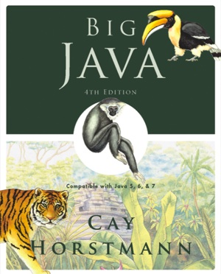
Chapter 4 – Fundamental Data Types

Slide 2
Chapter Goals
To understand integer and floating-point numbers
To recognize the limitations of the numeric types
To become aware of causes for overflow and roundoff errors
To understand the proper use of constants
To write arithmetic expressions in Java
To use the String type to define and manipulate character strings
To learn how to read program input and produce formatted output
Big Java by Cay Horstmann
Copyright © 2009 by John Wiley & Sons. All rights reserved.

Slide 3
Number Types
int: integers, no fractional part:
    1, -4, 0
double: floating-point numbers (double precision):
    0.5, -3.11111, 4.3E24, 1E-14
A numeric computation overflows if the result falls outside the
range for the number type:
    int n = 1000000;
    System.out.println(n * n); // prints -727379968
Java: 8 primitive types, including four integer types and two
floating point types
Big Java by Cay Horstmann
Copyright © 2009 by John Wiley & Sons. All rights reserved.

Slide 4
Primitive Types
Type | Description | Size
int | The integer type, with range -2,147,483,648 . . . 2,147,483,647 | 4 bytes
byte | The type describing a single byte, with range -128 . . . 127 | 1 byte
short | The short integer type, with range -32768 . . . 32767 | 2 bytes
long | The long integer type, with range -9,223,372,036,854,775,808 . . . 9,223,372,036,854,775,807 | 8 bytes
double | The double-precision floating-point type, with a range of about ±10³⁰⁸ and about 15 significant decimal digits | 8 bytes
float | The single-precision floating-point type, with a range of about ±10³⁸ and about 7 significant decimal digits | 4 bytes
char | The character type, representing code units in the Unicode encoding scheme | 2 bytes
boolean | The type with the two truth values false and true | 1 bit
Big Java by Cay Horstmann
Copyright © 2009 by John Wiley & Sons. All rights reserved.

Slide 5
Number Types: Floating-point Types
Rounding errors occur when an exact conversion between numbers is not possible:
double f = 4.35;
System.out.println(100 * f); // prints 434.99999999999994
Java: Illegal to assign a floating-point expression to an integer variable:
double balance = 13.75;
int dollars = balance; // Error
Big Java by Cay Horstmann
Copyright © 2009 by John Wiley & Sons. All rights reserved.

Slide 6
Self Check 4.1
Which are the most commonly used number types in Java?
  Answer: int and double

Slide 7
Self Check 4.3
Which of the following initializations are incorrect, and why?
  int dollars = 100.0;
  double balance = 100;
  Answer: The first initialization is incorrect. The right hand side is a value of type double, and it is not legal to initialize an int variable with a double value. The second initialization is correct — an int value can always be converted to a double.

Slide 8
Constants: final
A final variable is a constant
Once its value has been set, it cannot be changed
Named constants make programs easier to read and maintain
Convention: Use all-uppercase names for constants
final double QUARTER_VALUE = 0.25;
final double DIME_VALUE = 0.1;
final double NICKEL_VALUE = 0.05;
final double PENNY_VALUE = 0.01;
payment = dollars + quarters * QUARTER_VALUE
+ dimes * DIME_VALUE + nickels * NICKEL_VALUE
+ pennies * PENNY_VALUE;
Big Java by Cay Horstmann
Copyright © 2009 by John Wiley & Sons. All rights reserved.

Slide 9
Constants: static final
If constant values are needed in several methods, declare them together with the instance fields of a class and tag them as static and final
Give static final constants public access to enable other classes to use them
public class Math
{
. . .
public static final double E = 2.7182818284590452354;
public static final double PI = 3.14159265358979323846;
}
double circumference = Math.PI * diameter;
Big Java by Cay Horstmann
Copyright © 2009 by John Wiley & Sons. All rights reserved.

Slide 10
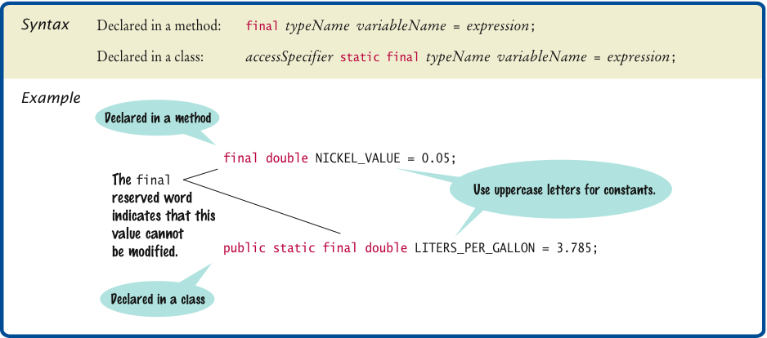
Syntax 4.1 Constant Definition
Big Java by Cay Horstmann
Copyright © 2009 by John Wiley & Sons. All rights reserved.

Slide 11
ch04/cashregister/CashRegister.java
1 /**
2 A cash register totals up sales and computes change due.
3 */
4 public class CashRegister
5 {
6 public static final double QUARTER_VALUE = 0.25;
7 public static final double DIME_VALUE = 0.1;
8 public static final double NICKEL_VALUE = 0.05;
9 public static final double PENNY_VALUE = 0.01;
10
11 private double purchase;
12 private double payment;
13
14 /**
15 Constructs a cash register with no money in it.
16 */
17 public CashRegister()
18 {
19 purchase = 0;
20 payment = 0;
21 }
22
Continued
Big Java by Cay Horstmann
Copyright © 2009 by John Wiley & Sons. All rights reserved.

Slide 12
ch04/cashregister/CashRegister.java (cont.)
23 /**
24 Records the purchase price of an item.
25 @param amount the price of the purchased item
26 */
27 public void recordPurchase(double amount)
28 {
29 purchase = purchase + amount;
30 }
31
32 /**
33 Enters the payment received from the customer.
34 @param dollars the number of dollars in the payment
35 @param quarters the number of quarters in the payment
36 @param dimes the number of dimes in the payment
37 @param nickels the number of nickels in the payment
38 @param pennies the number of pennies in the payment
39 */
40 public void enterPayment(int dollars, int quarters,
41 int dimes, int nickels, int pennies)
42 {
43 payment = dollars + quarters * QUARTER_VALUE + dimes * DIME_VALUE
44 + nickels * NICKEL_VALUE + pennies * PENNY_VALUE;
45 }
46
Continued
Big Java by Cay Horstmann
Copyright © 2009 by John Wiley & Sons. All rights reserved.

Slide 13
ch04/cashregister/CashRegister.java (cont.)
47 /**
48 Computes the change due and resets the machine for the next customer.
49 @return the change due to the customer
50 */
51 public double giveChange()
52 {
53 double change = payment - purchase;
54 purchase = 0;
55 payment = 0;
56 return change;
57 }
58 }
Big Java by Cay Horstmann
Copyright © 2009 by John Wiley & Sons. All rights reserved.

Slide 14
ch04/cashregister/CashRegisterTester.java
1 /**
2 This class tests the CashRegister class.
3 */
4 public class CashRegisterTester
5 {
6 public static void main(String[] args)
7 {
8 CashRegister register = new CashRegister();
9
10 register.recordPurchase(0.75);
11 register.recordPurchase(1.50);
12 register.enterPayment(2, 0, 5, 0, 0);
13 System.out.print("Change: ");
14 System.out.println(register.giveChange());
15 System.out.println("Expected: 0.25");
16
17 register.recordPurchase(2.25);
18 register.recordPurchase(19.25);
19 register.enterPayment(23, 2, 0, 0, 0);
20 System.out.print("Change: ");
21 System.out.println(register.giveChange());
22 System.out.println("Expected: 2.0");
23 }
24 }
Big Java by Cay Horstmann
Copyright © 2009 by John Wiley & Sons. All rights reserved.

Slide 15
ch04/cashregister/CashRegisterTester.java (cont.)
Program Run:
  Change: 0.25
  Expected: 0.25
  Change: 2.0
  Expected: 2.0
Big Java by Cay Horstmann
Copyright © 2009 by John Wiley & Sons. All rights reserved.

Slide 16
Self Check 4.4
What is the difference between the following two statements?
final double CM_PER_INCH = 2.54;
and
public static final double CM_PER_INCH = 2.54;
Answer: The first definition is used inside a method, the second
inside a class.

Slide 17
Self Check 4.5
What is wrong with the following statement sequence?
double diameter = . . .;
double circumference = 3.14 * diameter;
  Answer:
    You should use a named constant, not the “magic number” 3.14.
    3.14 is not an accurate representation of π.

Slide 18
Arithmetic Operators
Four basic operators:
    addition: +
    subtraction: -
    multiplication: *
    division: /
Parentheses control the order of subexpression computation:
  (a + b) / 2
Multiplication and division bind more strongly than addition and subtraction:
    (a + b) / 2
Big Java by Cay Horstmann
Copyright © 2009 by John Wiley & Sons. All rights reserved.

Slide 19
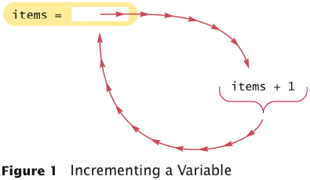
Increment and Decrement
items++ is the same as items = items + 1
items-- subtracts 1 from items
Big Java by Cay Horstmann
Copyright © 2009 by John Wiley & Sons. All rights reserved.

Slide 20
Integer Division
/ is the division operator
If both arguments are integers, the result is an integer. The
remainder is discarded
7.0 / 4 yields 1.75
7 / 4 yields 1
Get the remainder with % (pronounced “modulo”)
7 % 4 is 3
Big Java by Cay Horstmann
Copyright © 2009 by John Wiley & Sons. All rights reserved.

Slide 21
Integer Division
Example:
final int PENNIES_PER_NICKEL = 5;
final int PENNIES_PER_DIME = 10;
final int PENNIES_PER_QUARTER = 25;
final int PENNIES_PER_DOLLAR = 100;
// Compute total value in pennies
int total = dollars * PENNIES_PER_DOLLAR + quarters
* PENNIES_PER_QUARTER + nickels * PENNIES_PER_NICKEL
+ dimes * PENNIES_PER_DIME + pennies;
// Use integer division to convert to dollars, cents
int dollars = total / PENNIES_PER_DOLLAR;
int cents = total % PENNIES_PER_DOLLAR;
Big Java by Cay Horstmann
Copyright © 2009 by John Wiley & Sons. All rights reserved.

Slide 22

Powers and Roots
Math class: contains methods sqrt and pow to compute square roots and powers
To compute x^{n}, you write Math.pow(x, n)
However, to compute x² it is significantly more efficient simply
to compute x * x
To take the square root of a number, use Math.sqrt; for
example, Math.sqrt(x)
In Java,
can be represented as
(-b + Math.sqrt(b * b - 4 * a * c)) / (2 * a)
Big Java by Cay Horstmann
Copyright © 2009 by John Wiley & Sons. All rights reserved.

Slide 23
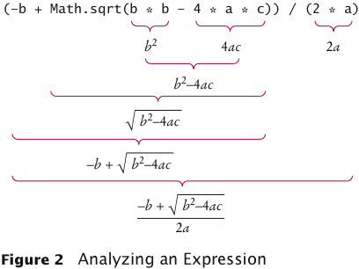
Analyzing an Expression
Big Java by Cay Horstmann
Copyright © 2009 by John Wiley & Sons. All rights reserved.

Slide 24
Mathematical Methods
Function | Returns
Math.sqrt(x) | square root
Math.pow(x, y) | power x^{y}
Math.exp(x) | e^{x}
Math.log(x) | natural log
Math.sin(x), Math.cos(x), Math.tan(x) | sine, cosine, tangent (x in radians)
Math.round(x) | closest integer to x
Math.min(x, y), Math.max(x, y) | minimum, maximum
Big Java by Cay Horstmann
Copyright © 2009 by John Wiley & Sons. All rights reserved.

Slide 25
Cast and Round
Cast converts a value to a different type:
  double balance = total + tax;
  int dollars = (int) balance;
Math.round converts a floating-point number to nearest integer:
  long rounded = Math.round(balance);
  // if balance is 13.75, then rounded is set to 14
Big Java by Cay Horstmann
Copyright © 2009 by John Wiley & Sons. All rights reserved.

Slide 26
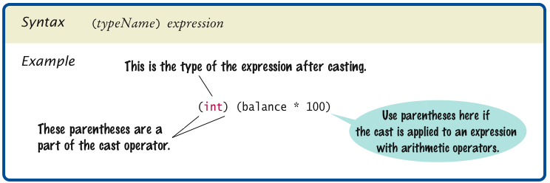
Syntax 4.2 Cast
Big Java by Cay Horstmann
Copyright © 2009 by John Wiley & Sons. All rights reserved.

Slide 27
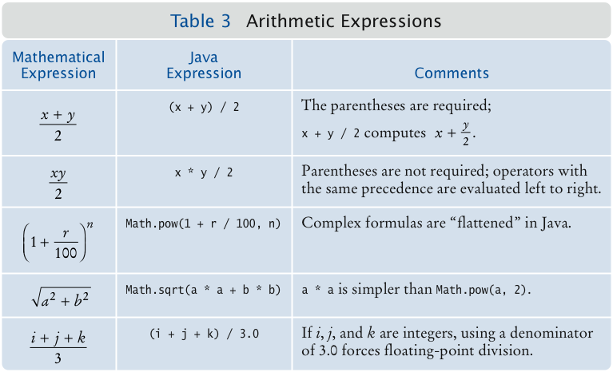
Arithmetic Expressions
Big Java by Cay Horstmann
Copyright © 2009 by John Wiley & Sons. All rights reserved.

Slide 28
Self Check 4.6
What is the value of n after the following sequence of statements?
n--;
n++;
n--;
  Answer: One less than it was before.

Slide 29
Self Check 4.7
What is the value of 1729 / 100? Of 1729 % 100?
  Answer: 17 and 29

Slide 30
Self Check 4.8
Why doesn’t the following statement compute the average of s1, s2, and s3?
double average = s1 + s2 + s3 / 3; // Error
  Answer: Only s3 is divided by 3. To get the correct result, use parentheses. Moreover, if s1, s2, and s3 are integers, you must divide by 3.0 to avoid integer division:
(s1 + s2 + s3) / 3.0

Slide 31

Self Check 4.9
What is the value of Math.sqrt(Math.pow(x, 2) + Math.pow(y, 2)) in mathematical notation?
  Answer:

Slide 32
Self Check 4.10
When does the cast (long) x yield a different result from the call Math.round(x)?
  Answer: When the fractional part of x is ≥ 0.5

Slide 33
Self Check 4.11
How do you round the double value x to the nearest int value, assuming that you know that it is less than 2 · 109?
  Answer: By using a cast: (int) Math.round(x)

Slide 34
Calling Static Methods
A static method does not operate on an object
double x = 4;
double root = x.sqrt(); // Error
Static methods are declared inside classes
Naming convention: Classes start with an uppercase letter; objects start with a lowercase letter:
Math
System.out
Big Java by Cay Horstmann
Copyright © 2009 by John Wiley & Sons. All rights reserved.

Slide 35
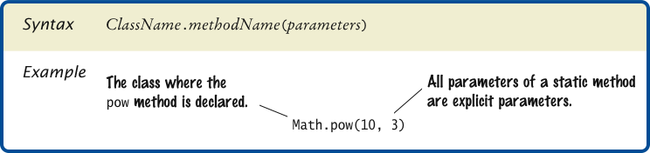
Syntax 4.3 Static Method Call
Big Java by Cay Horstmann
Copyright © 2009 by John Wiley & Sons. All rights reserved.

Slide 36
Self Check 4.12
Why can’t you call x.pow(y) to compute x^{y}?
  Answer: x is a number, not an object, and you cannot invoke methods on numbers.

Slide 37
Self Check 4.13
Is the call System.out.println(4) a static method call?
  Answer: No – the println method is called on the object System.out.

Slide 38
The String Class
A string is a sequence of characters
Strings are objects of the String class
A string literal is a sequence of characters enclosed in double quotation marks:
"Hello, World!"
String length is the number of characters in the String
  Example: "Harry".length() is 5
Empty string: ""
Big Java by Cay Horstmann
Copyright © 2009 by John Wiley & Sons. All rights reserved.

Slide 39
Concatenation
Use the + operator:
String name = "Dave";
String message = "Hello, " + name;
// message is "Hello, Dave"
If one of the arguments of the + operator is a string, the other is converted to a string
String a = "Agent”;
int n = 7;
String bond = a + n; // bond is "Agent7"
Big Java by Cay Horstmann
Copyright © 2009 by John Wiley & Sons. All rights reserved.

Slide 40
Concatenation in Print Statements
Useful to reduce the number of System.out.print instructions:
System.out.print("The total is ");
System.out.println(total);
versus
System.out.println("The total is " + total);
Big Java by Cay Horstmann
Copyright © 2009 by John Wiley & Sons. All rights reserved.

Slide 41
Converting between Strings and Numbers
Convert to number:
int n = Integer.parseInt(str);
double x = Double.parseDouble(x);
Convert to string:
String str = "" + n;
str = Integer.toString(n);
Big Java by Cay Horstmann
Copyright © 2009 by John Wiley & Sons. All rights reserved.

Slide 42

Substrings
String greeting = "Hello, World!";
String sub = greeting.substring(0, 5); // sub is "Hello"
Supply start and “past the end” position
First position is at 0
Big Java by Cay Horstmann
Copyright © 2009 by John Wiley & Sons. All rights reserved.

Slide 43
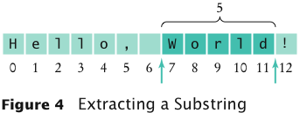
Substrings
String sub2 = greeting.substring(7, 12); // sub2 is "World"
Substring length is “past the end” - start
Big Java by Cay Horstmann
Copyright © 2009 by John Wiley & Sons. All rights reserved.

Slide 44
Self Check 4.14
Assuming the String variable s holds the value "Agent", what is the effect of the assignment s = s + s.length()?
  Answer: s is set to the string Agent5

Slide 45
Self Check 4.15
Assuming the String variable river holds the value "Mississippi ", what is the value of river.substring(1, 2)? Of river.substring(2, river.length() - 3)?
  Answer: The strings "i" and "ssissi"

Slide 46
Reading Input
System.in has minimal set of features — it can only read one
byte at a time
In Java 5.0, Scanner class was added to read keyboard input in
a convenient manner
Scanner in = new Scanner(System.in);
System.out.print("Enter quantity:");
int quantity = in.nextInt();
nextDouble reads a double
nextLine reads a line (until user hits Enter)
next reads a word (until any white space)
Big Java by Cay Horstmann
Copyright © 2009 by John Wiley & Sons. All rights reserved.

Slide 47
ch04/cashregister/CashRegisterSimulator.java
1 import java.util.Scanner;
2
3 /**
4 This program simulates a transaction in which a user pays for an item
5 and receives change.
6 */
7 public class CashRegisterSimulator
8 {
9 public static void main(String[] args)
10 {
11 Scanner in = new Scanner(System.in);
12
13 CashRegister register = new CashRegister();
14
15 System.out.print("Enter price: ");
16 double price = in.nextDouble();
17 register.recordPurchase(price);
18
19 System.out.print("Enter dollars: ");
20 int dollars = in.nextInt();
Continued
Big Java by Cay Horstmann
Copyright © 2009 by John Wiley & Sons. All rights reserved.

Slide 48
ch04/cashregister/CashRegisterSimulator.java (cont.)
21 System.out.print("Enter quarters: ");
22 int quarters = in.nextInt();
23 System.out.print("Enter dimes: ");
24 int dimes = in.nextInt();
25 System.out.print("Enter nickels: ");
26 int nickels = in.nextInt();
27 System.out.print("Enter pennies: ");
28 int pennies = in.nextInt();
29 register.enterPayment(dollars, quarters, dimes, nickels, pennies);
30
31 System.out.print("Your change: ");
32 System.out.println(register.giveChange());
33 }
34 }
Continued
Big Java by Cay Horstmann
Copyright © 2009 by John Wiley & Sons. All rights reserved.

Slide 49
ch04/cashregister/CashRegisterSimulator.java (cont.)
Program Run:
  Enter price: 7.55
  Enter dollars: 10
  Enter quarters: 2
  Enter dimes: 1
  Enter nickels: 0
  Enter pennies: 0
  Your change: is 3.05
Big Java by Cay Horstmann
Copyright © 2009 by John Wiley & Sons. All rights reserved.

Slide 50
Self Check 4.16
Why can’t input be read directly from System.in?
Answer: The class only has a method to read a single byte. It
would be very tedious to form characters, strings, and numbers
from those bytes.

Slide 51
Self Check 4.17
Suppose in is a Scanner object that reads from System.in, and your program calls
String name = in.next();
What is the value of name if the user enters John Q. Public?
Answer: The value is "John". The next method reads the next word.

Slide 52
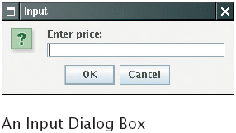
Reading Input From a Dialog Box
Big Java by Cay Horstmann
Copyright © 2009 by John Wiley & Sons. All rights reserved.

Slide 53
Reading Input From a Dialog Box
String input = JOptionPane.showInputDialog(prompt)
Convert strings to numbers if necessary:
    int count = Integer.parseInt(input);
Conversion throws an exception if user doesn’t supply a number — see Chapter 11
Add System.exit(0) to the main method of any program that uses JOptionPane
Big Java by Cay Horstmann
Copyright © 2009 by John Wiley & Sons. All rights reserved.

